Slide 1


LandSlide EWAS
Aris Theophilou, Giannis Kaoullas, Kyriakos Arnaoutis, Panayiotis Makris, Antonis Papadopoulos
Notes:
My name is Aris Theophilou, and I would like to welcome you to the presentation of our project, named Ladslide EWAS, which acronym means “Early Warning System”. Our project has been submitted for the Track a Landslide Challenge.

Slide 2

Problem
Landslides occur due to the rise of the water level in the ground, usually after a prolonged rainfall. They usually result in extensive monetary, material, and social losses. For example, a recent landslide in Washington resulted in 33 casualties.
Notes:
Let’s start with the definition of the problem. Landslides occur due to the rise of the water level in the ground, usually after a prolonged rainfall. They usually result in extensive monetary, material, and social losses. For example, a recent landslide in Washington resulted in 33 casualties.

Slide 3
Solution
Develop an early warning system that informs people about the likelihood of a landslide in a particular area. The system sends messages to people’s mobiles, informing them (1) that the area is safe (green), (2) there is a potential for a landslide (orange), and (3) the area should be immediately evacuated (red).
Notes:
In order to provide a solution to the problem, we developed an early warning system that informs people about the likelihood of a landslide in a particular area. The system sends messages to people’s mobiles, informing them that either the area is safe, in which case it displays a green colour, or that there is a potential for a landslide, in which case it displays an orange colour, or that the area should be immediately evacuated, in which case it displays a red colour.

Slide 4
System Components
Measure the water level in the ground (used fictitious data).
Central console to read the water level data in real-time.
Mathematical model that evaluates the potential of a landslide, termed “Factor of Safety”.
Website on which the Factor of Safety, together with the respective colour code are posted.
Mobile phone application that reads the website data and displays the corresponding colour code.
Notes:
The system that we developed consists of five components: The first component measures the water level in the ground, through piezometric sensors that are installed at the bottom of boreholes; obviously we did not have the time and resources needed to develop this component, so we used fictitious data. The second component is a central console, which is used to read the water level data in real time. The third component is a mathematical model that evaluates the potential of a landslide and gives the results in terms of the Factor of Safety, which is described in the next slide. The fourth component is a website on which the factor of safety and the respective colour code are posted. The fifth component is a mobile phone application that displays the corresponding colour code.

Slide 5
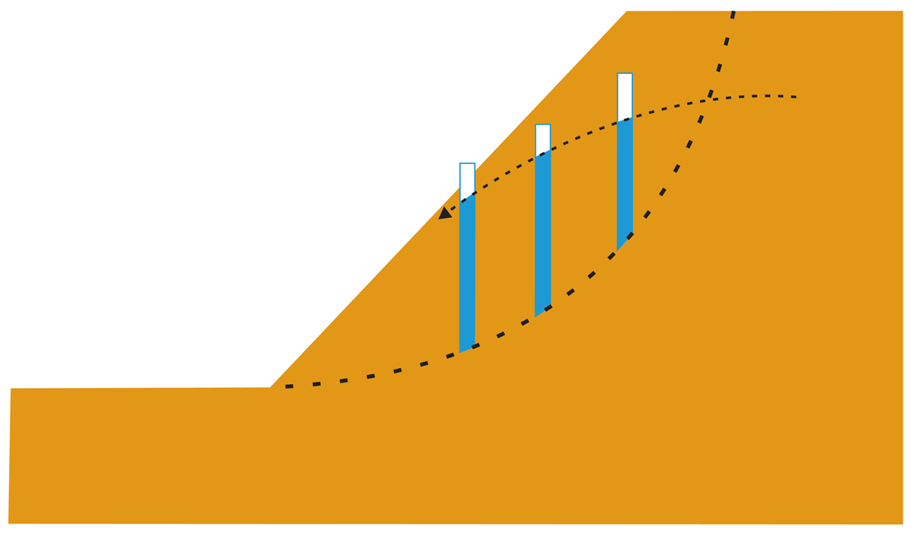
Mathematical Model
Slope stability evaluation using Bishop’s method
Notes:
For the purposes of the present challenge we evaluated the potential of a landslide, using a slope with a fixed geometry and ground properties. In order to evaluate the potential of a landslide we developed a mathematical model which is based on Bishop’s method, which is a widely used method for slope stability evaluation in the field of geotechnical engineering. In summary, Bishop’s method evaluates the factor of safety of a slope, as the ratio of the resisting forces along a rupture plane, shown here in dashed line, and the overturning moments due to gravity. A critical factor that causes landslides is the elevation of the water level in the ground, which in turn, reduces the resistance. So, in our problem we measured the water table in seven locations along the slope. The mathematical model gave us the factor of safety, which in turn was posted on the website.

Slide 6
Demonstration

Slide 7
Thank you!

